Slide 1

Modelling Monoclonal Antibody Therapies for Cancer
Luke Heirene
Helen Byrne
Eamonn Gaffney
James Yates

Slide 2
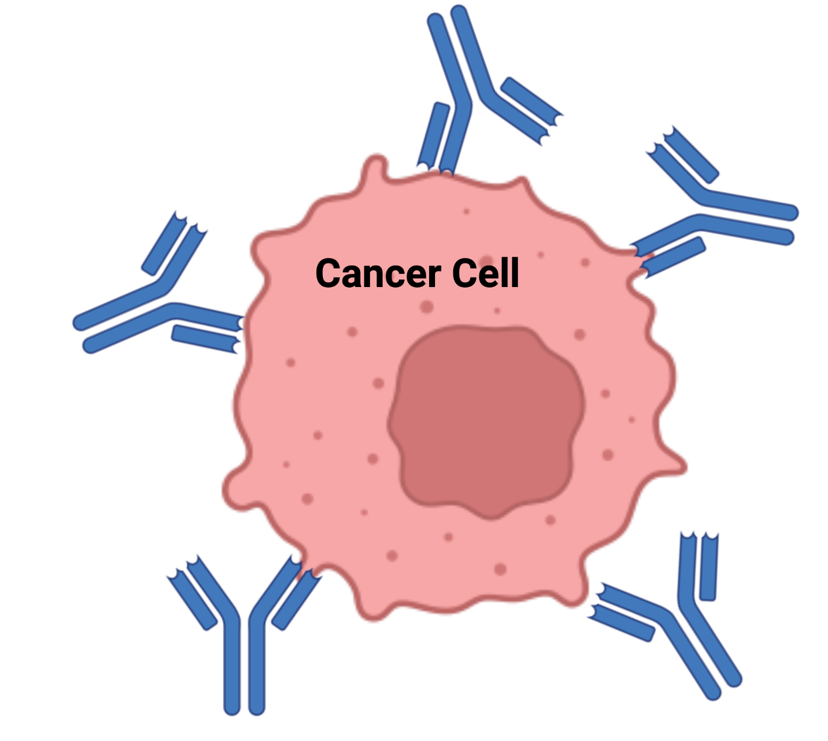
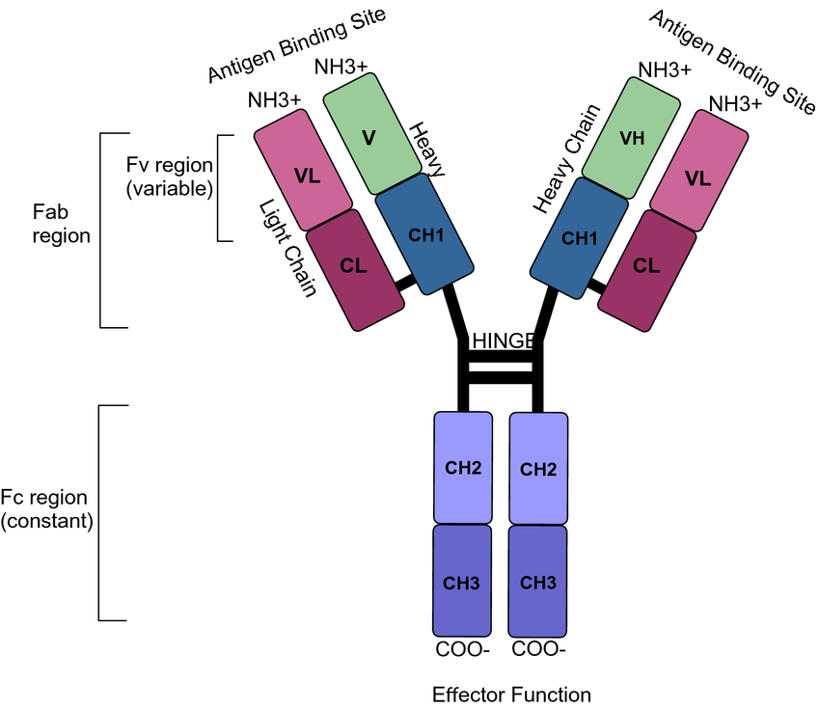
Monoclonal Antibodies (mAbs)
Diseases
Cancer
Alzheimer’s disease
Autoimmune diseases
Types
Monospecifics
Bispecifics
NK/T cell engagers
ADCs

Slide 3
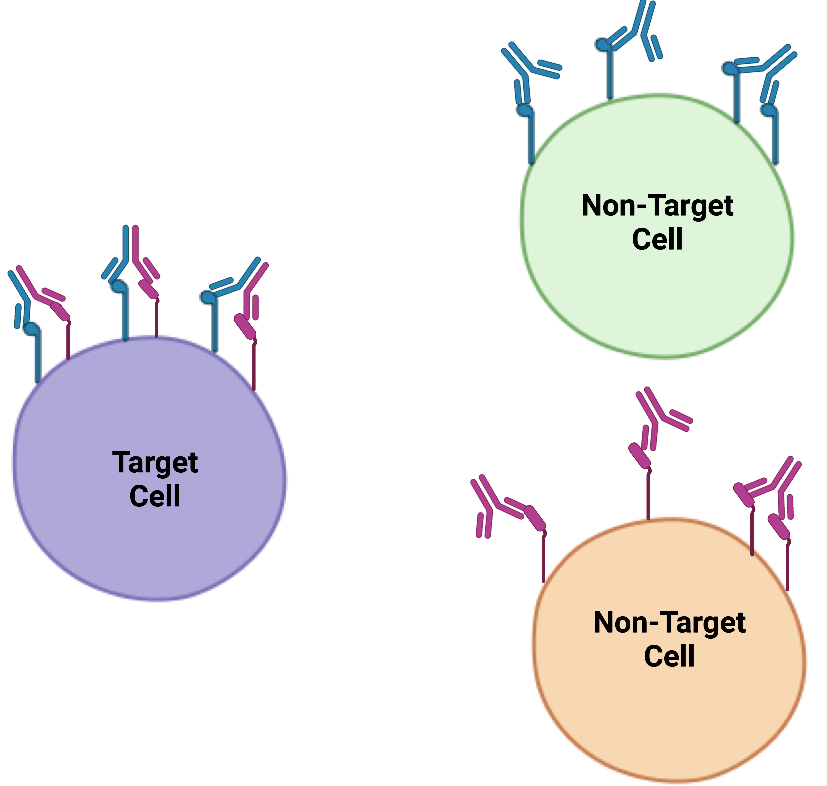
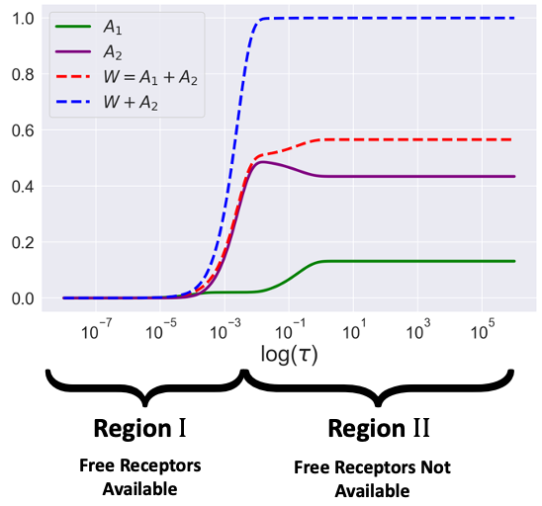
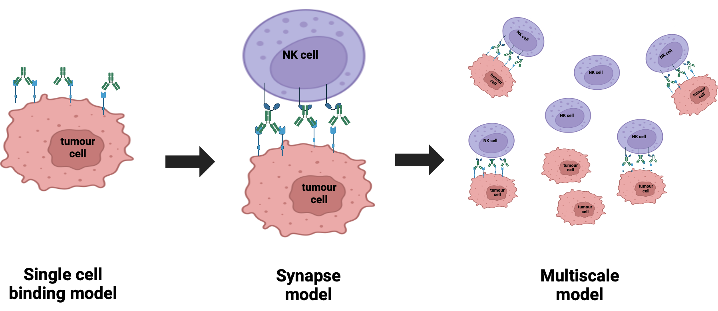
Asymptotic Analysis of Bivalent Antibody-Receptor Dynamics
Modelling Bispecific Selectivity
Multiscale ADCC Model

Slide 4
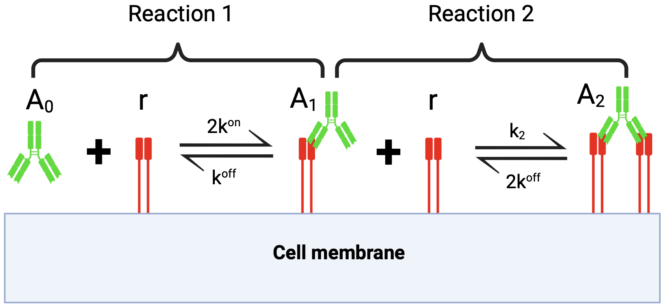
Asymptotic Analysis of Bivalent Antibody-Receptor Dynamics: Motivation
Ligand-receptor binding is fundamental in Biology
Common therapeutic antibodies are bivalent ligands
Multiple processes happening on different timescales

Slide 5
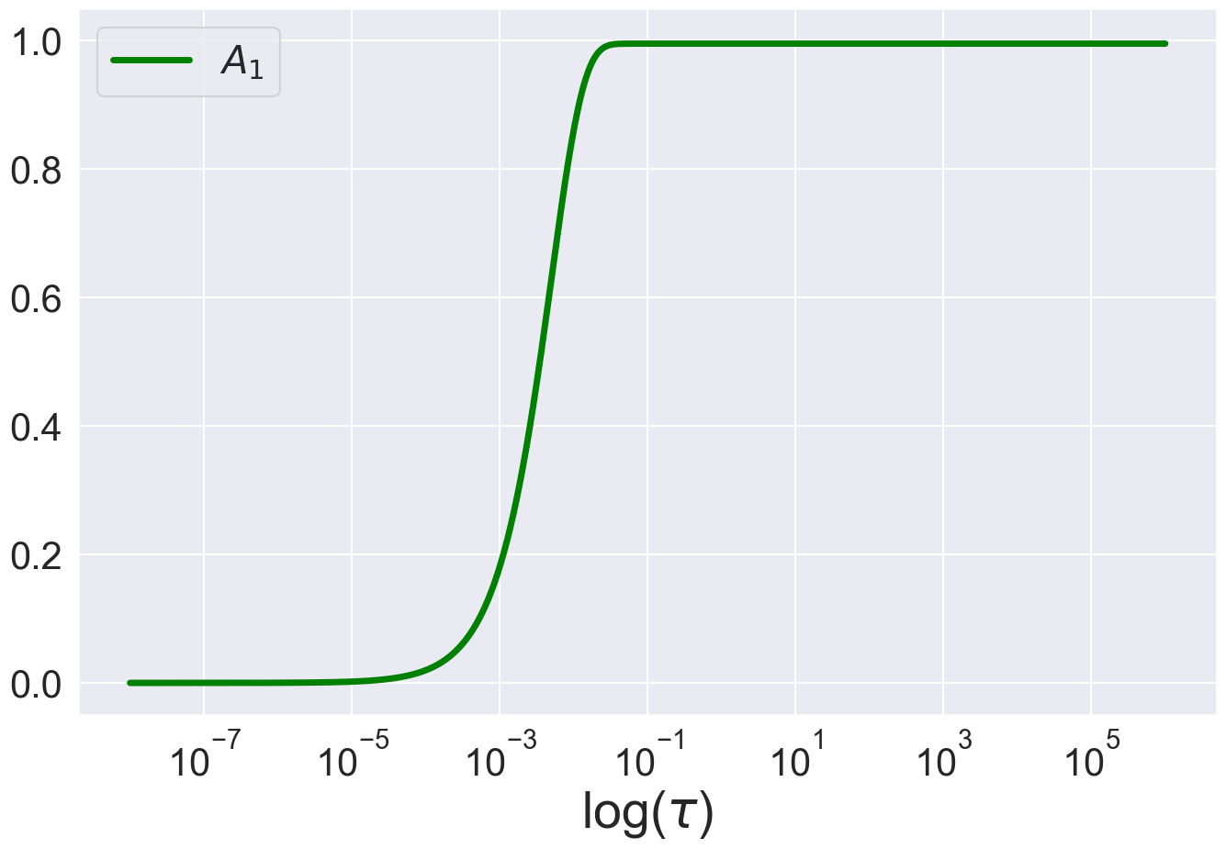
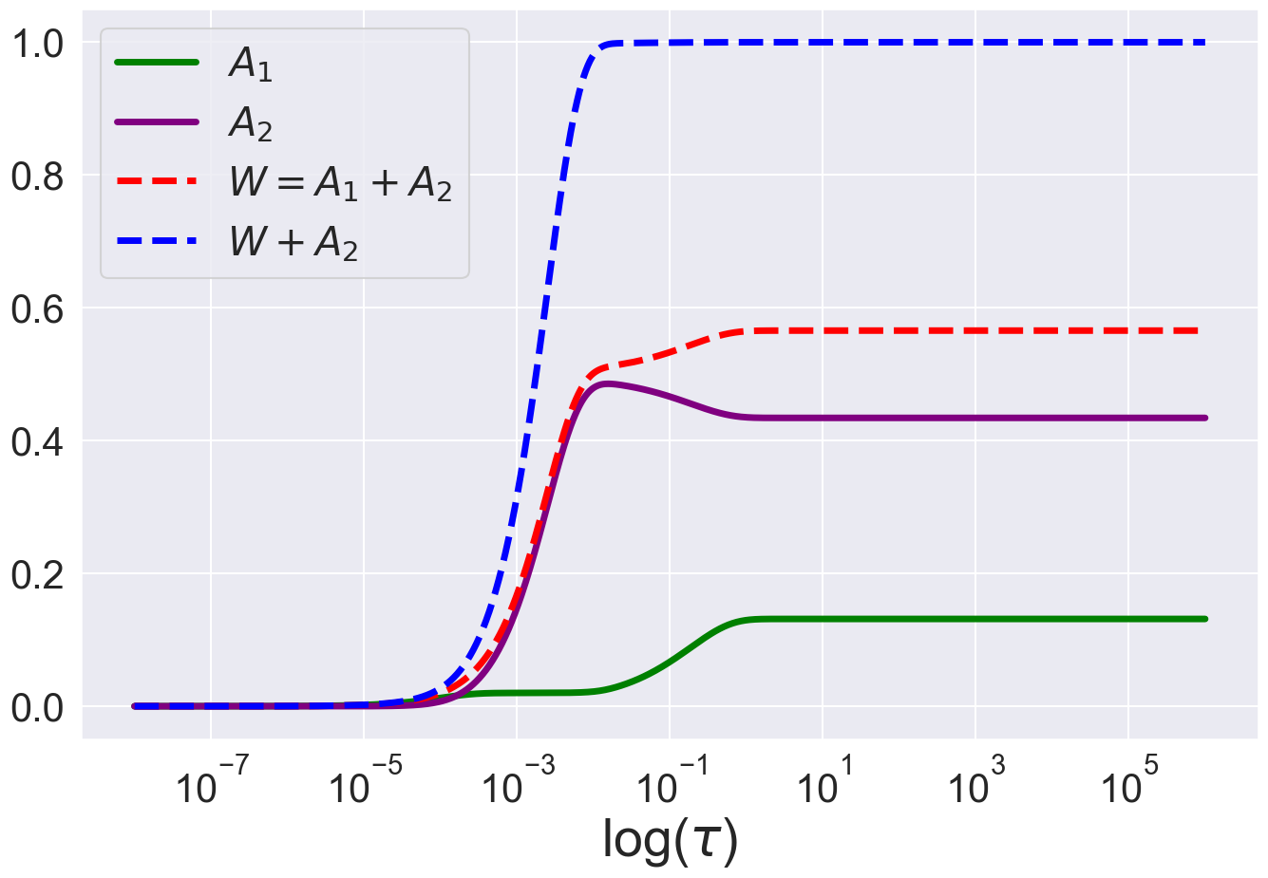
Research Questions
Monovalent case very simple
Can we capture complex dynamics of bivalent case?
How does the antibody dose affect the dynamics?

Slide 6
Monovalent Dissociation
Monovalent Binding
Bivalent Dissociation
Bivalent Binding

Slide 7
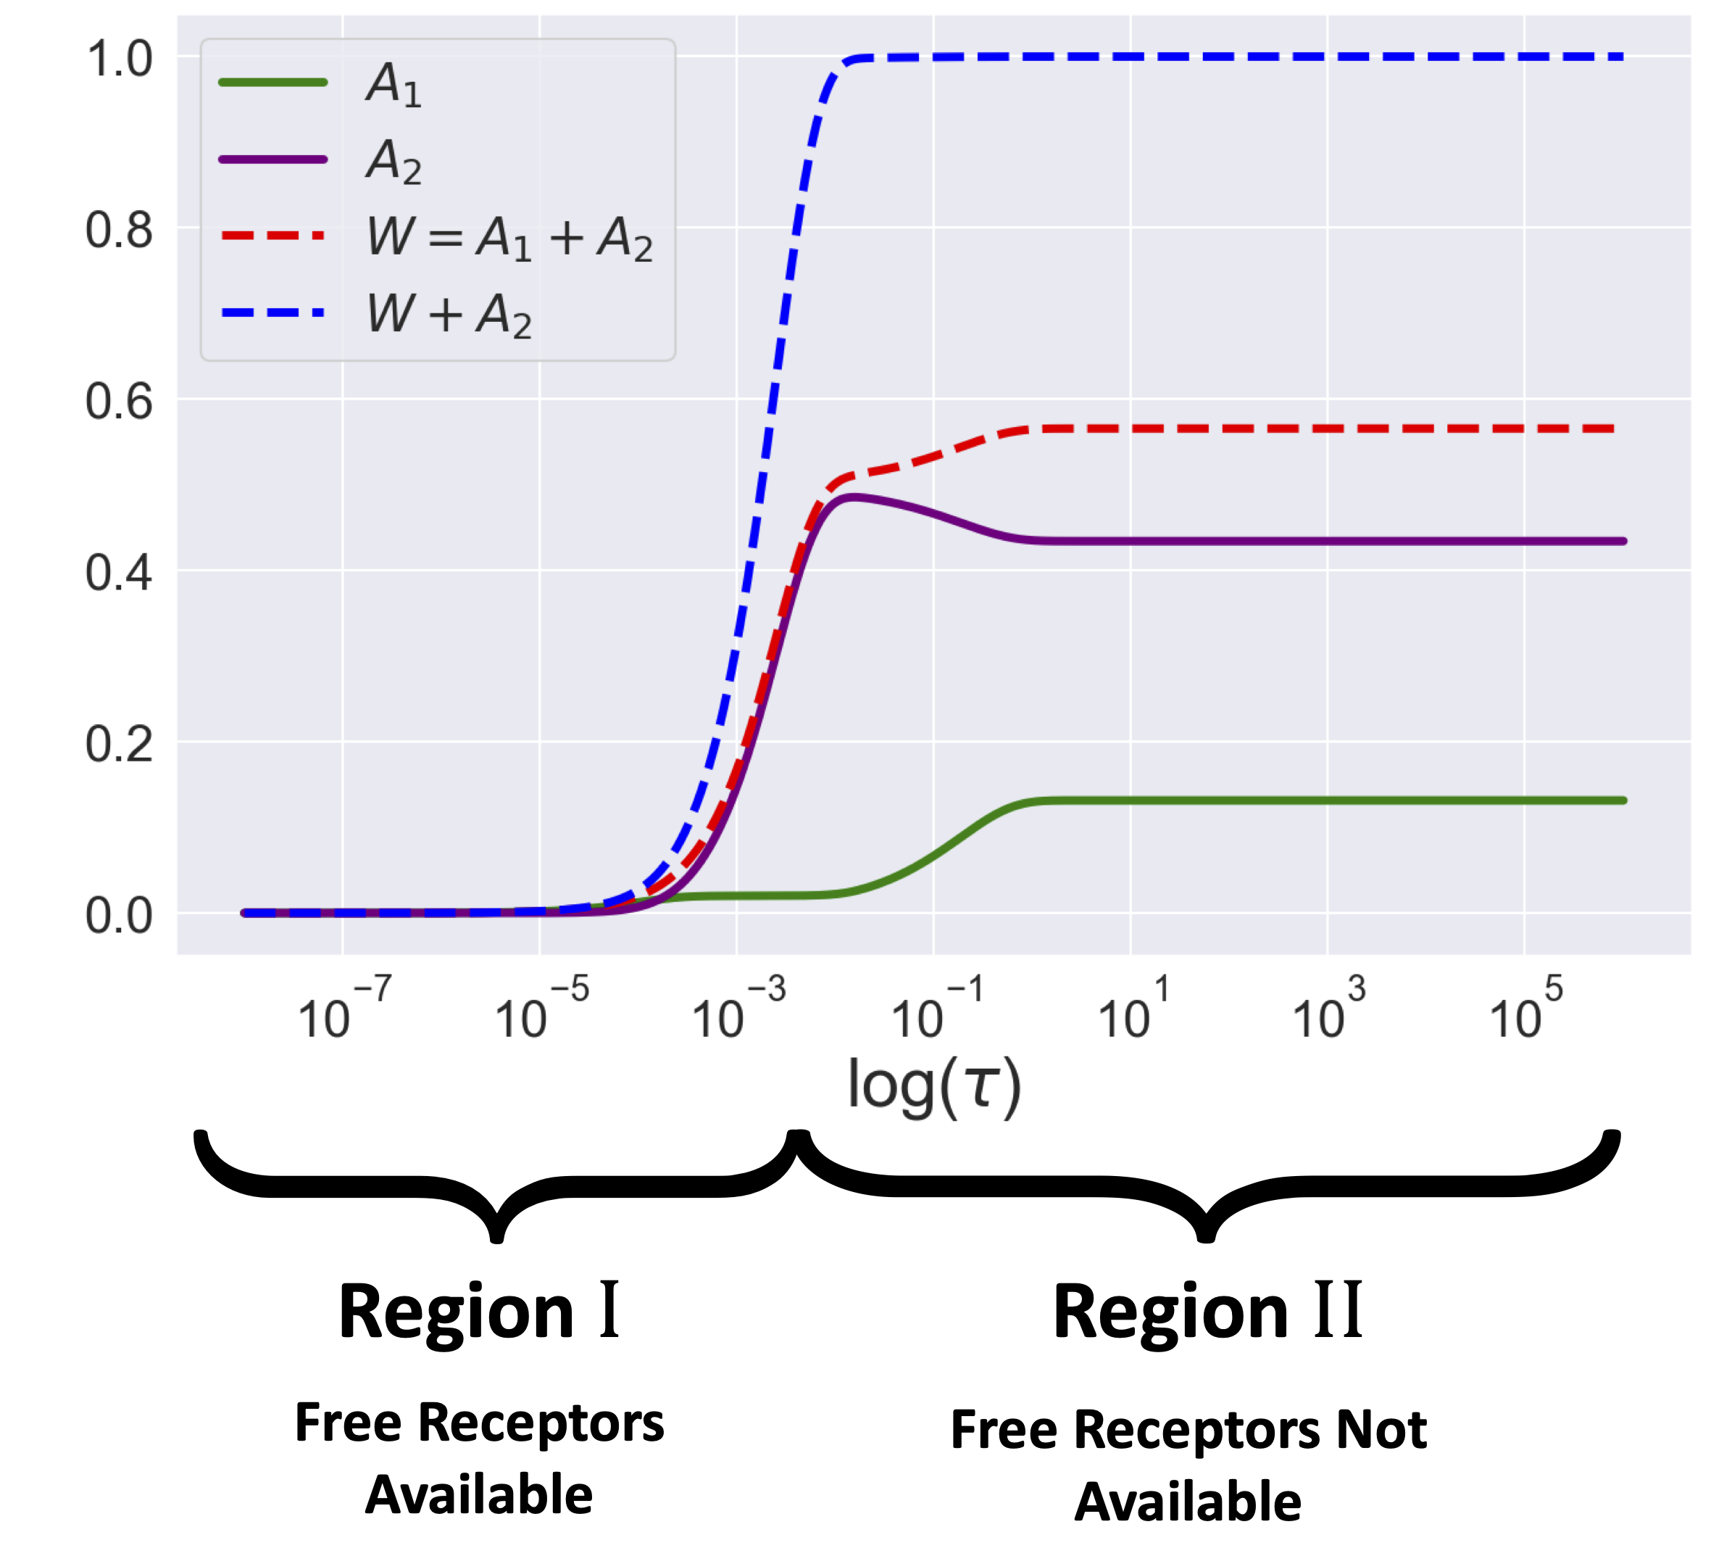
Dissociation events driven by lack of free receptors

Slide 8
Modelling Bispecific Selectivity
Off-target reactivity is a problem for many antibody therapies
Target receptors are often highly expressed on both tumour and non-tumour cells
Dual-targeting using Bispecifics seeks to remedy this by employing the avidity effect
GSK working on engineering cell numbers

Slide 9
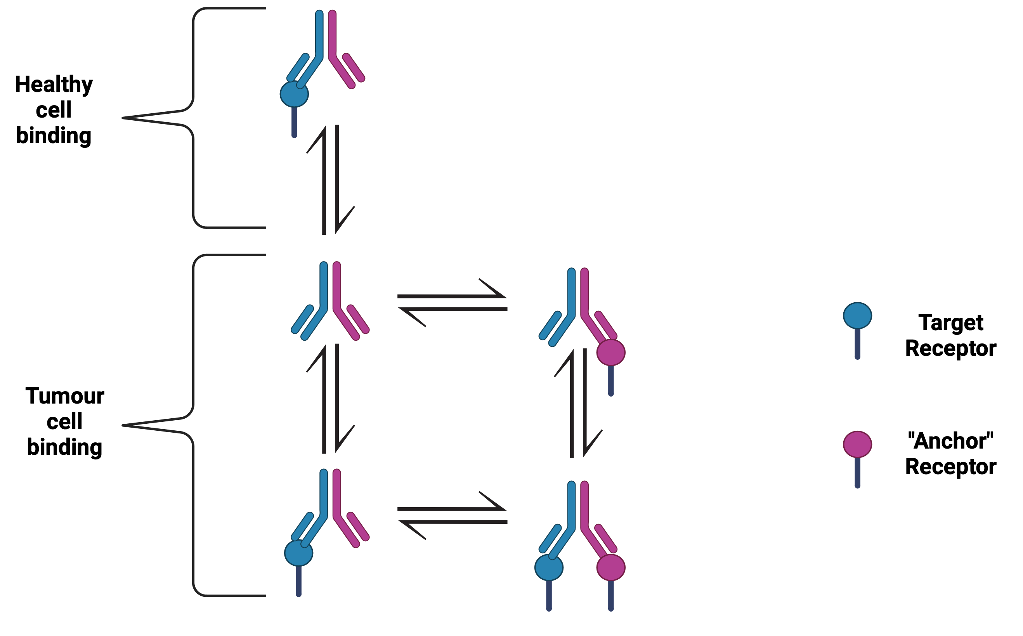
Model Schematic

Slide 10
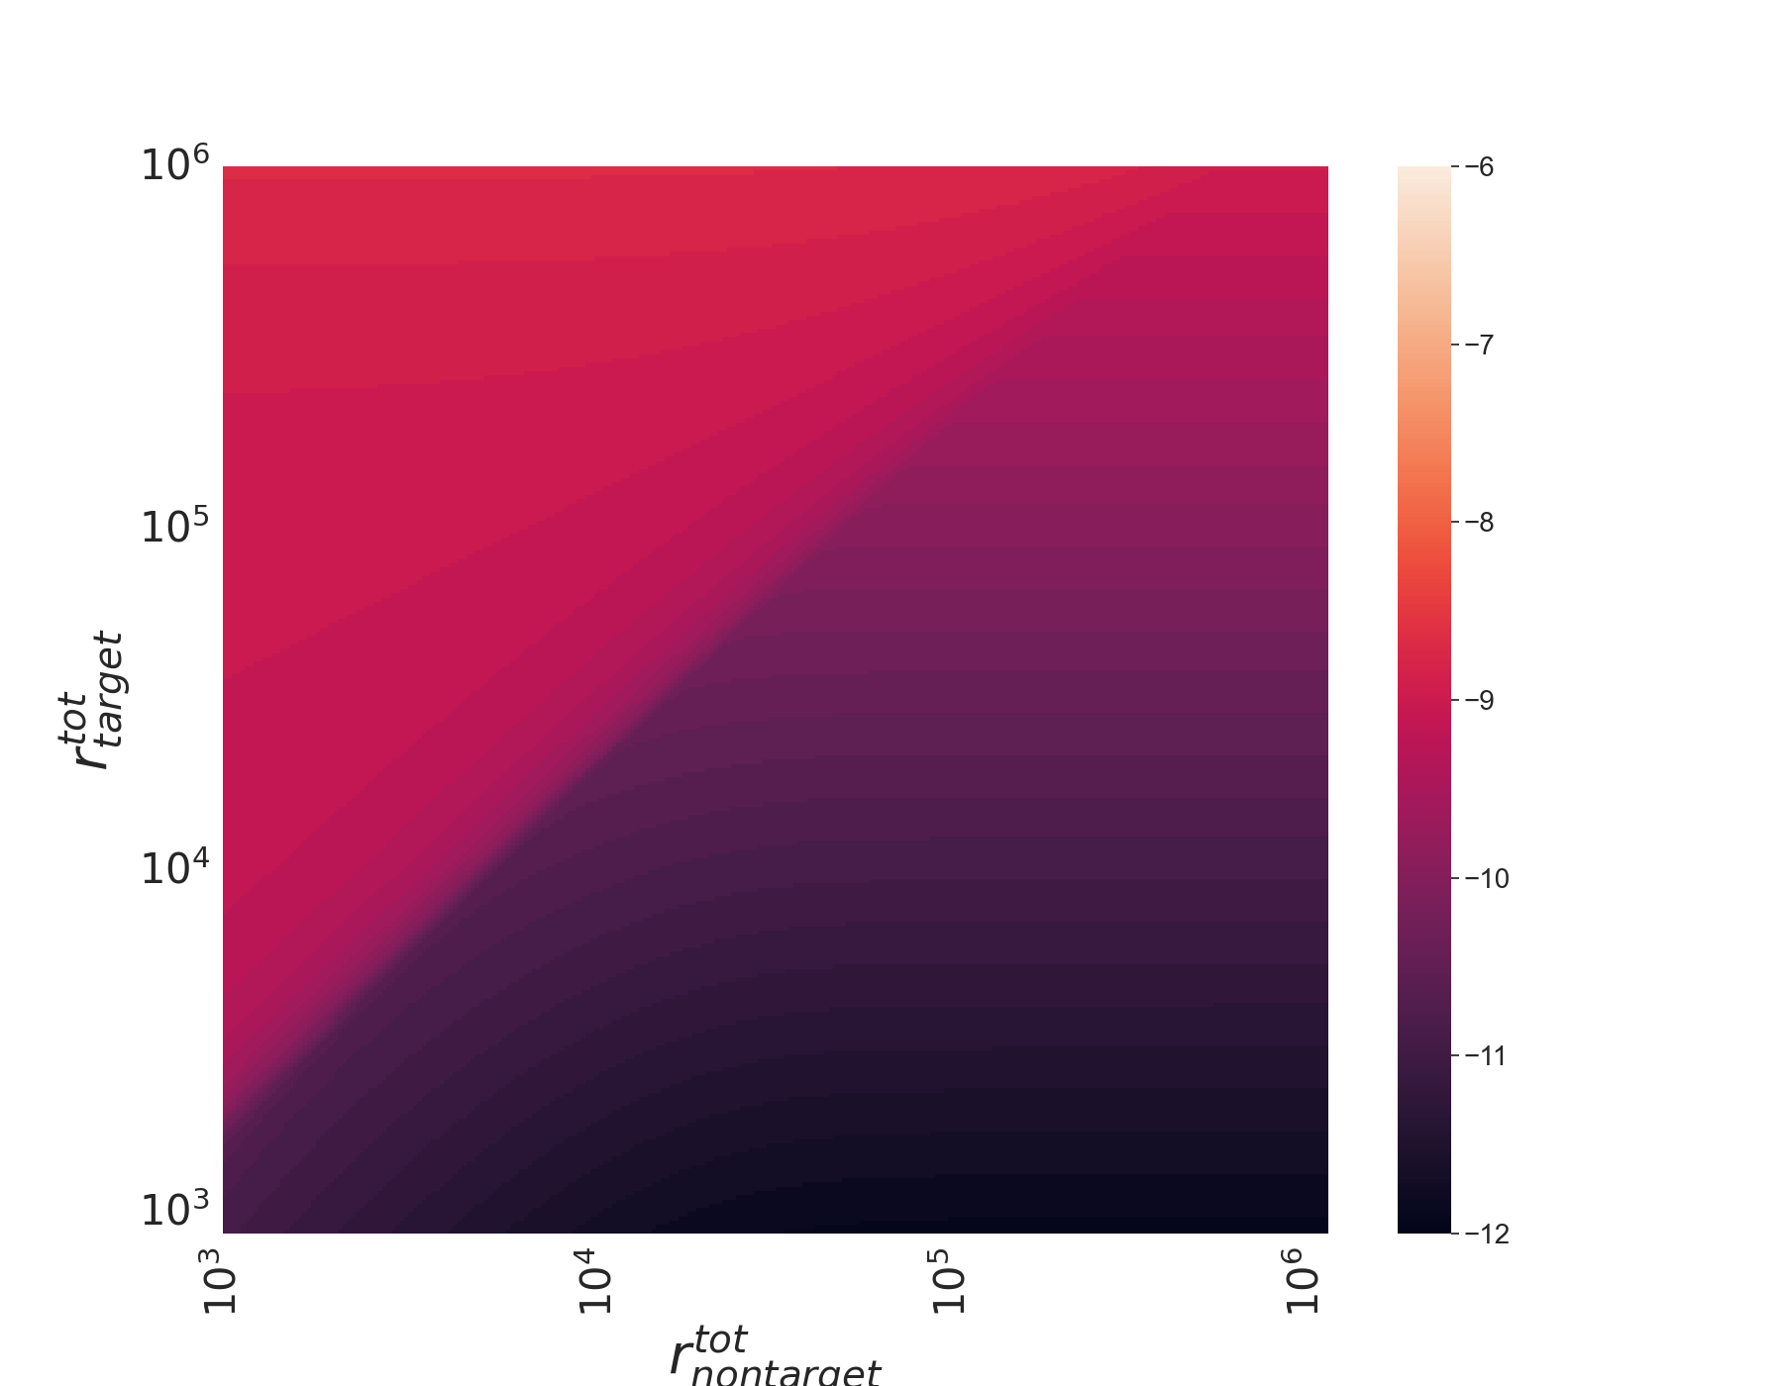
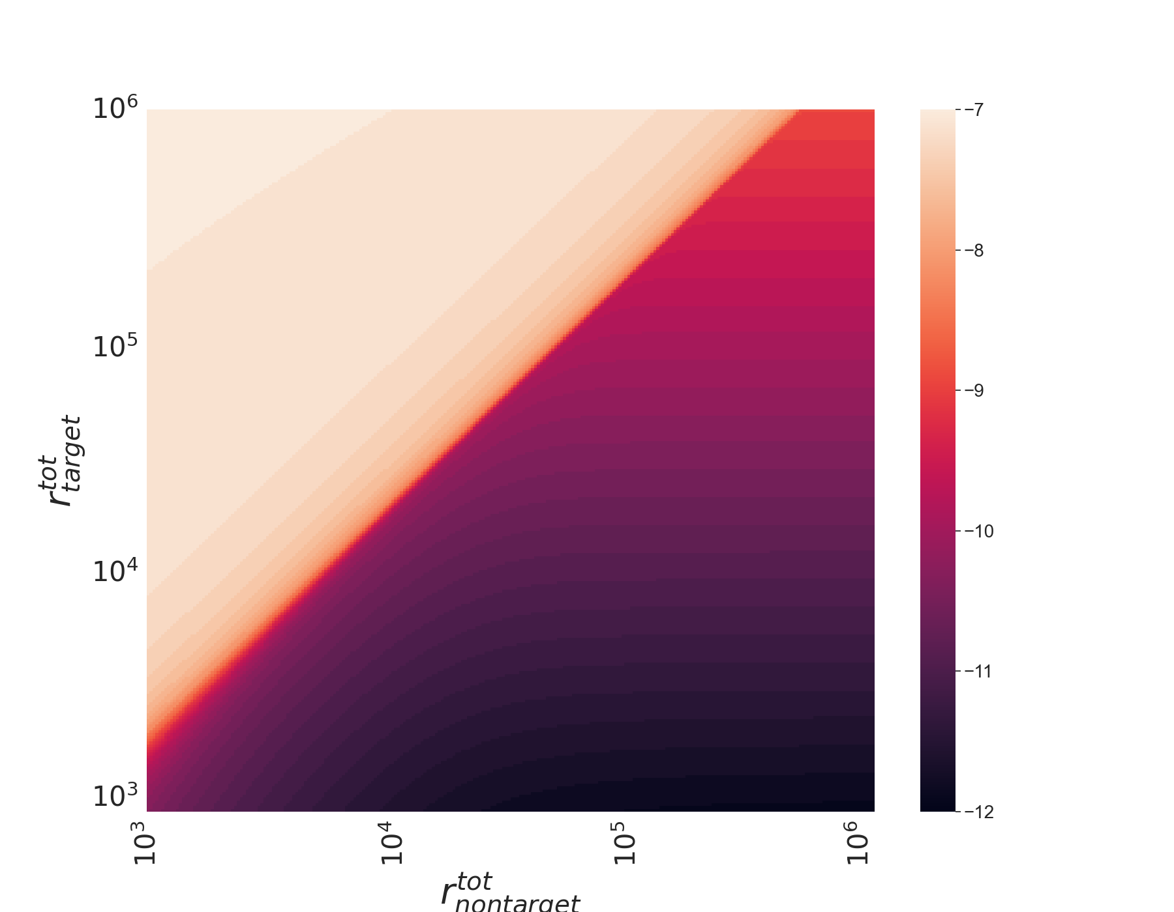
Tumour Cell EC50 Heatmaps

Slide 11
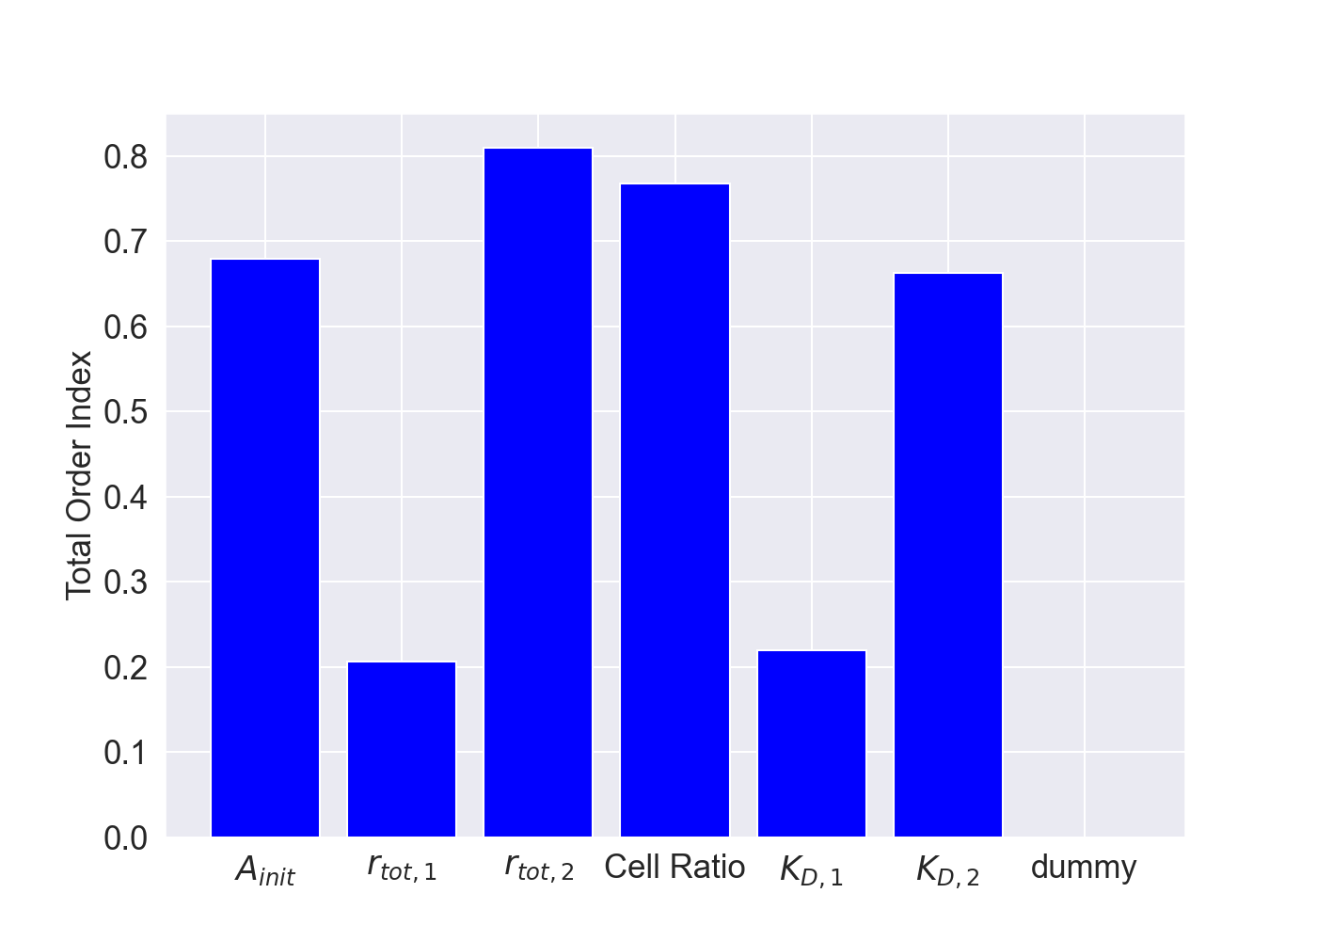
Selectivity Sensitivity Analysis
Target receptor associated parameters
not as important

Slide 12
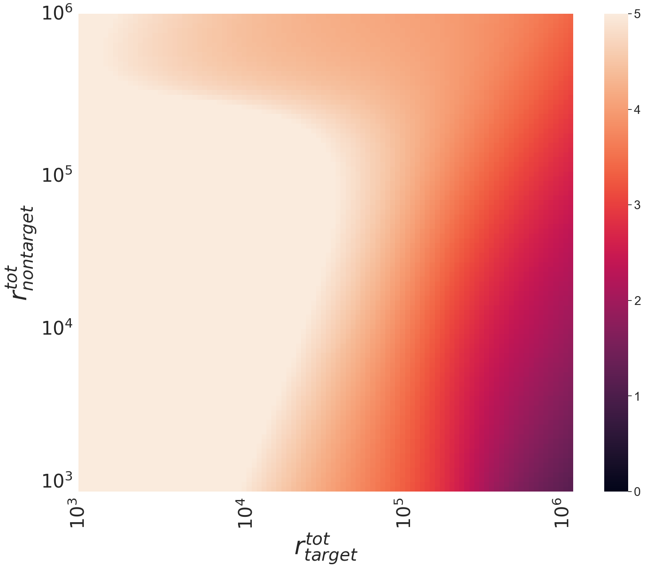
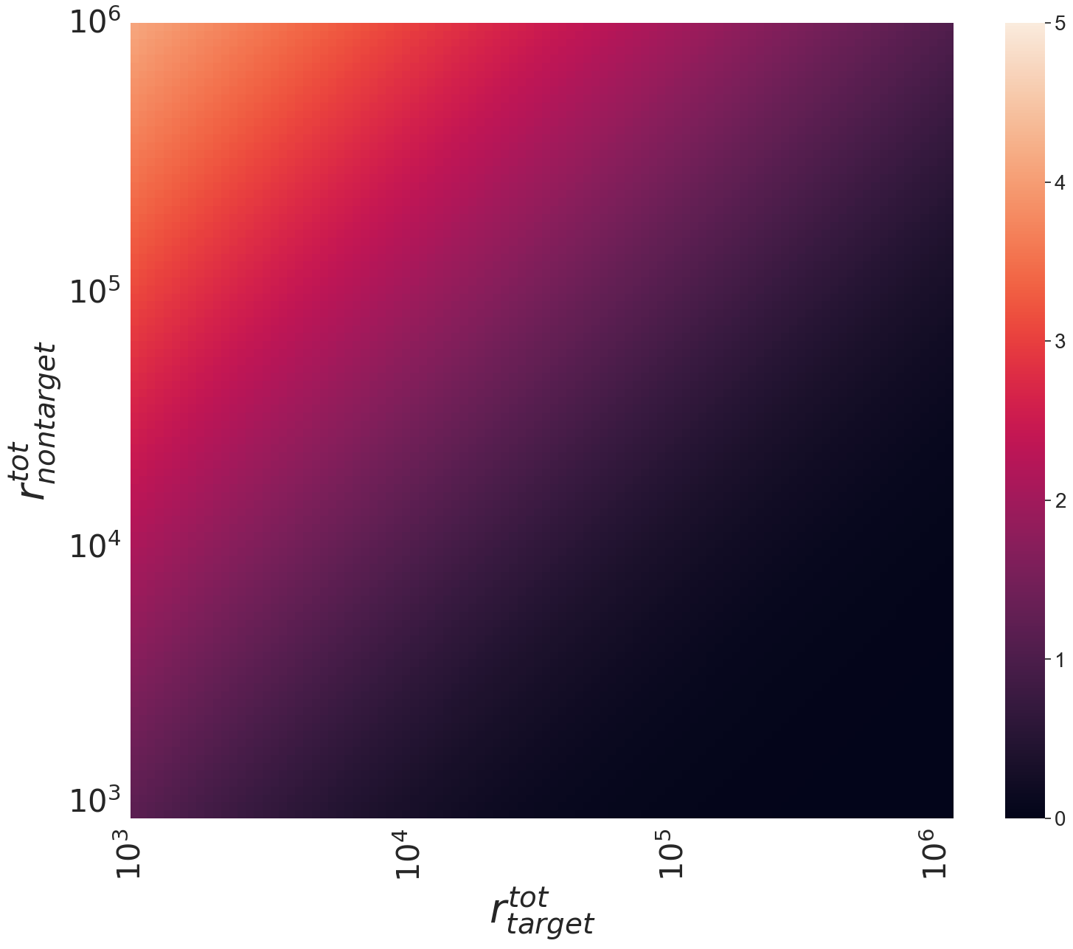
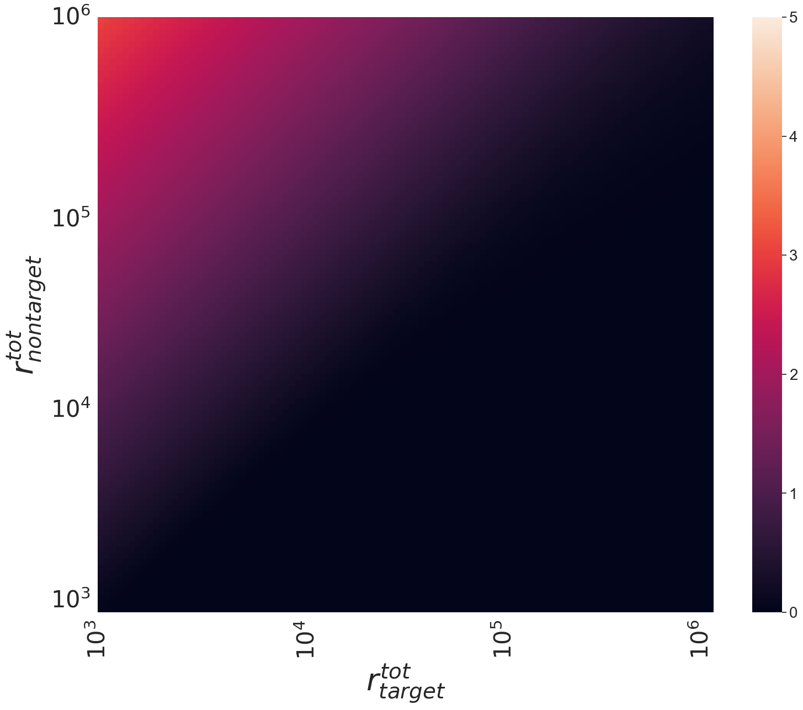

Slide 13
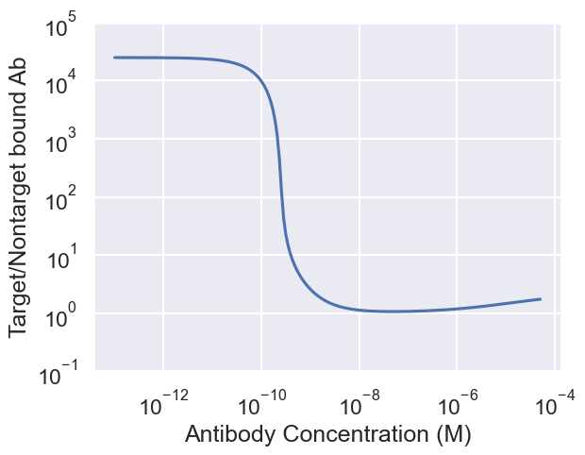
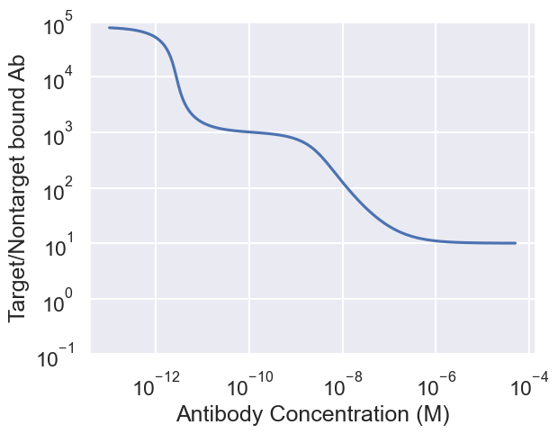

Slide 14
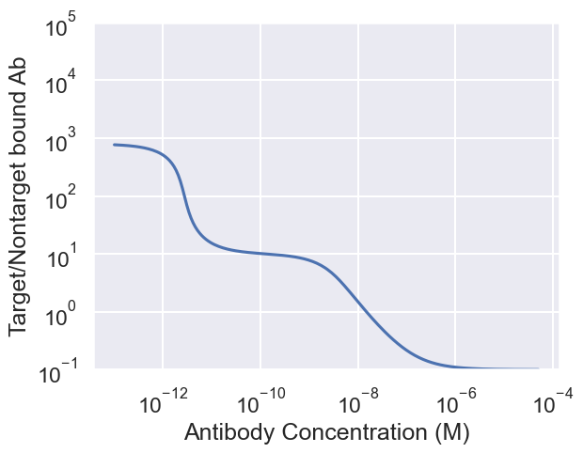
Effect of healthy: tumour cell ratio
100 x more healthy cells

Slide 15
Conclusions
Selectivity is dependent on antibody concentration, cell number ratio and anchor receptor numbers and affinity.
Increasing anchor receptor numbers can improve selectivity
Goldilocks zone for selectivity
Future work: test predictions experimentally

Slide 16
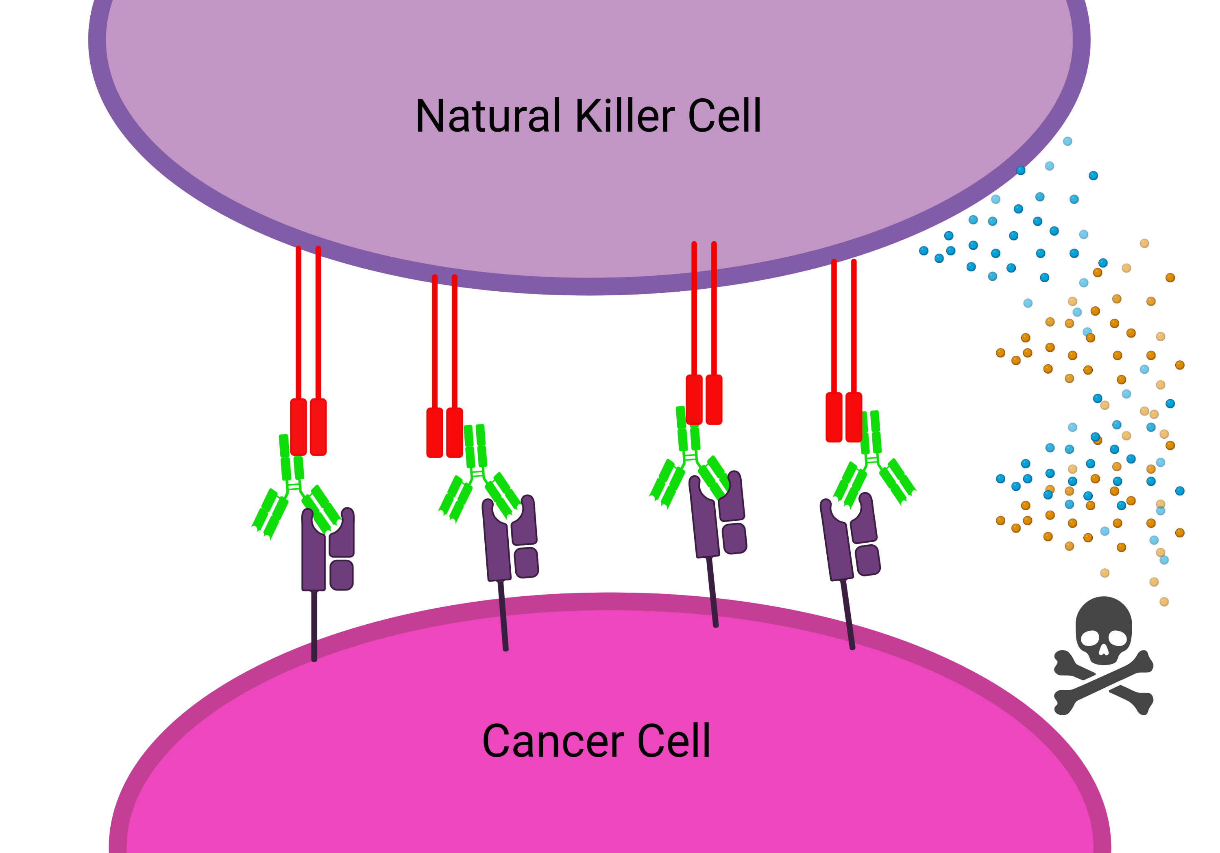
General Synapse Model and Multiscale ADCC Model
Motivation
ADCC is a common effector function of mAb therapies
Many factors can affect treatment efficacy
Opportunity to use mathematical modelling to inform experiments and explore ways to optimize efficacy
Model Components
Multiple Fc receptor types
Endogenous and therapeutic antibody
Tumour and effector cells

Slide 17
Putting the Pieces Together
Reaches equilibrium quickly

Slide 18
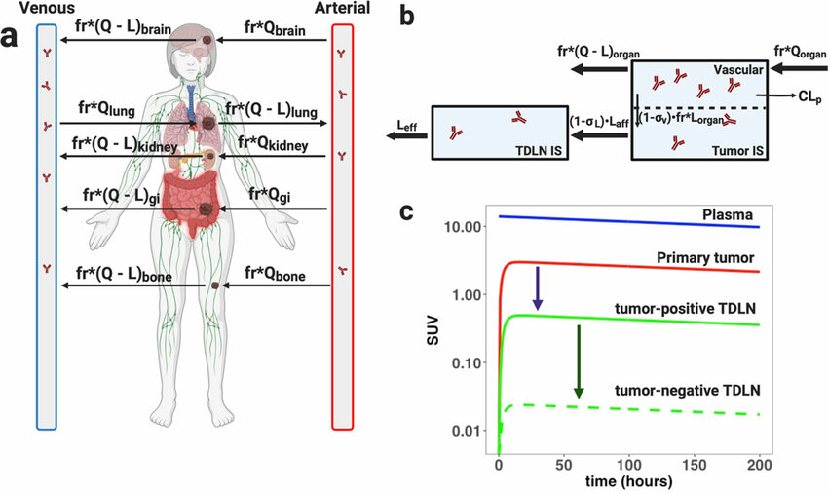
Linking with PK PD Models
April 2021 Mathematical Biosciences & Engineering 18(1):112-131
DOI:10.3934/mbe.2021006

Slide 19
Questions?

